Slide 1
Team Name:ECE DAZZLERS
Project Title: Building an Interactive Chatbot using React js and GPT API
Project Done By
KRITHIK GOKUL S

Slide 2
Abstract
This project aims to develop an interactive chatbot using React.js and the GPT API.
The chatbot will be able to understand and respond to user input, providing a conversational interface for users to interact with the system.
The goal is to create a user-friendly and engaging experience for users, while also leveraging the capabilities of the GPT API to provide accurate and helpful responses.

Slide 3
Problem Statement
The problem statement is to develop a chatbot that can understand and respond to user input in a natural and conversational manner, using the GPT API as the underlying technology.
The chatbot should be able to handle a wide range of topics and provide accurate and helpful responses to user queries.

Slide 4
Existing System
The existing system is based on traditional web development technologies, where users interact with the system through a simple form or interface.
The system does not have any conversational capabilities and relies on static content to respond to user queries.

Slide 5
Proposed System
The proposed system is an interactive chatbot that uses React.js and the GPT API to provide a conversational interface for users.
The chatbot will be able to understand and respond to user input, providing a more engaging and user-friendly experience.

Slide 6
Software Requirements
Front-end Development Used: React.js
Back-end Development Used: Node.js
API Used: GPT API
Database Used: Not required for this project

Slide 7
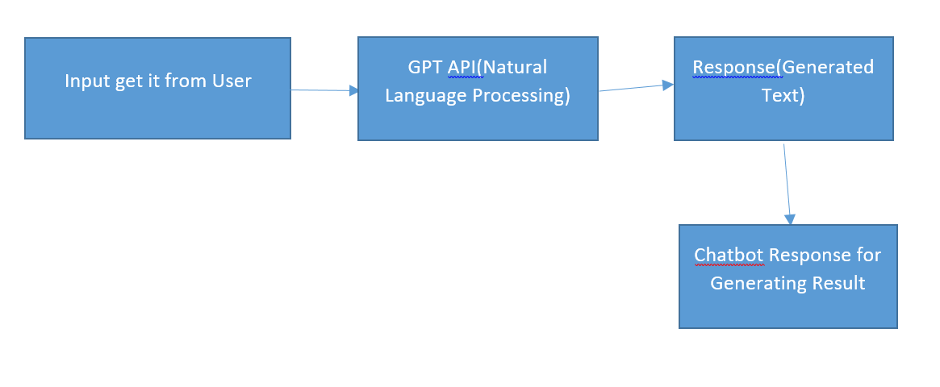
Flowchart

Slide 8
Deployment Process
Github Link:
Pieces for Developers Software Deployment Link:
Documentation Link:

Slide 9
Advantages
Improved user experience through conversational interface
Increased engagement and interaction with the system
Ability to handle a wide range of topics and provide accurate responses

Slide 10
Future Scope
The future scope of this project includes:
Integration with other AI technologies, such as machine learning and computer vision
Development of more advanced conversational interfaces, such as voice assistants
Expansion of the chatbot's capabilities to include tasks such as booking appointments or making reservations

Slide 11
Applications
The chatbot can be applied in a variety of industries, including:
Customer service: providing automated support and answering customer queries.
Education: providing interactive learning experiences and helping students with their coursework.
Healthcare: providing health-related information and support to patients.

Slide 12
Conclusion
In conclusion, this project aims to develop an interactive chatbot using React.js and the GPT API.
The chatbot will provide a conversational interface for users, allowing them to interact with the system in a more engaging and user-friendly manner.
The project has several advantages, including improved user experience, increased engagement, and the ability to handle a wide range of topics.
The future scope of this project includes integration with other AI technologies and expansion of the chatbot's capabilities.

Slide 13
References
GPT API documentation: <https://beta.openai.com/docs/api>
React.js documentation: <https://reactjs.org/docs/getting-started.html>
Node.js documentation: <https://nodejs.org/en/docs/>

